Slide 1
Research Lifecyle so far
We are now here.
We started from here
Final Results and Analysis
Implementation of instance segmentation model
Again research for an instance segmentation model
Implementation of object detection model
Some more data collection
Research for a good object detection model
Comparison of two different models performance
Model implementation for two class classification
Research for a model to use
Data collection
Research about the topic

Slide 2
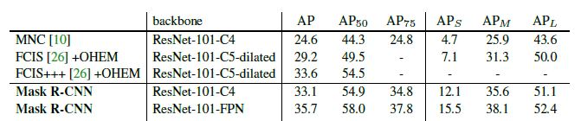
Comparing our best result with papers result
Batch size | Backbone | AP | AP₅₀ | AP₇₅ | AP_{S} | AP_{M} | AP_{L}
4 | ResNet-101-FPN | 28.110 | 55.028 | 25.047 | 14.784 | 26.824 | 34.167

Slide 3
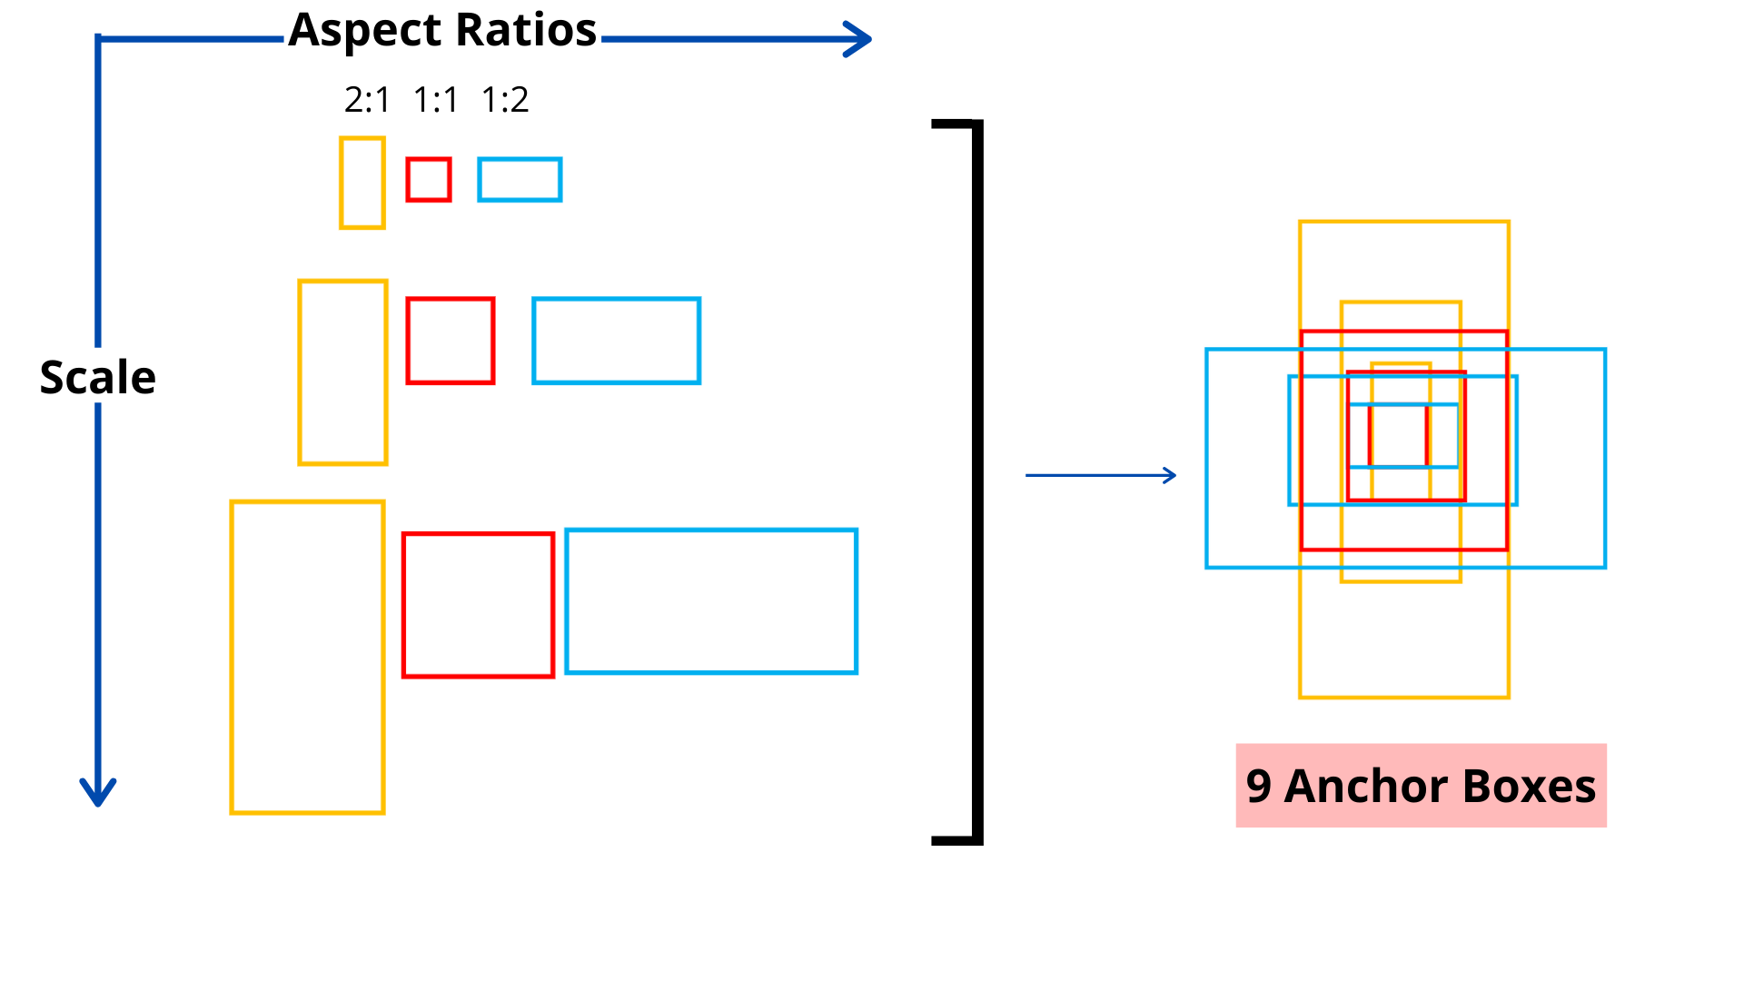
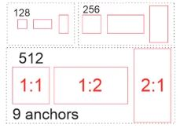
How does the algorithm determine a small, medium, or large object?

Slide 4
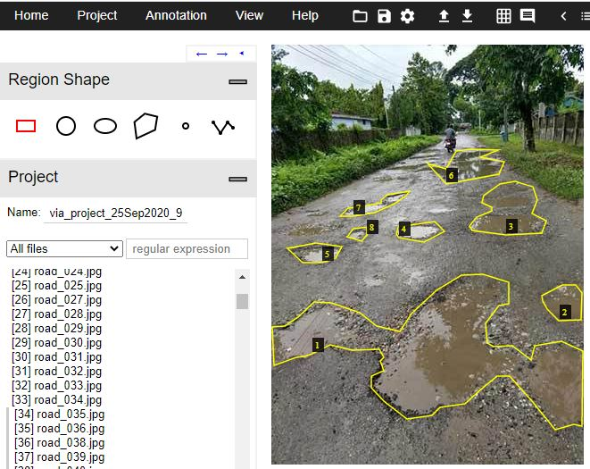
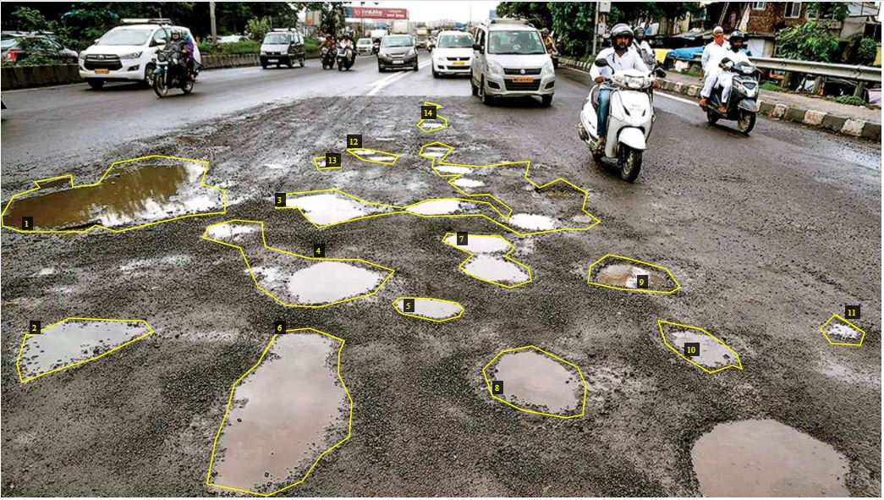
Instances

Slide 5
Potential solution
Instance sorting Function
Dataset
Instances from image samples
512
256
128
Small Box
Medium Box
Large Box

